Slide 1
Linear regression
Session 2:
The principles of linear regression

Slide 2
Session 2: The principles of linear regression
Scatter plot
Linear equation
Residual variation
Table of analysis of variance
Coefficient of determination
Correlation coefficient
Statistical test: F-test
Confidence intervals
Notes:
The term “multiple” in “multiple regression” is explained by the fact that the number of independent variables in the model is larger than 1.
The analysis of variance will help us to determine the “goodness of fit”, the technical term for what might also be called “precision” of the model. It will clarify the role of each variable, and help to decide which variable(s) to put into the model, taking the principle of parsimony into account.
We shall see that a strategy is needed to define the most appropriate order by which terms are introduced into the model.
See further!

Slide 3
Dataset: Cholesterol.csv
age | cholesterol | sex | occupation | bmi | activity
20 | 1.9 | M | 4 | 16.7 | 24
22 | 2.1 | F | 4 | 19.2 | 22
28 | 2.3 | M | 2 | 22.1 | 24
22 | 2.5 | M | 1 | 20.8 | 26
24 | 2.5 | F | 4 | 20.9 | 18
30 | 2.6 | M | 2 | 18.7 | 13
28 | 2.9 | F | 3 | 22.9 | 6
25 | 3.0 | M | 2 | 22.3 | 8
33 | 3.0 | F | 4 | 24.8 | 9
34 | 3.2 | M | 2 | 22.9 | 0
40 | 3.2 | M | 3 | 21.4 | 8
29 | 3.3 | F | 4 | 23.8 | 17
50 | 3.3 | F | 1 | 23.0 | 5
46 | 3.5 | M | 3 | 22.7 | 12
36 | 3.8 | F | 4 | 24.8 | 3
43 | 3.8 | F | 4 | 25.7 | 3
58 | 3.9 | M | 3 | 25.7 | 6
49 | 4.0 | M | 2 | 28 | 8
52 | 4.0 | M | 2 | 25.3 | 2
57 | 4.1 | F | 3 | 30.3 | 5
48 | 4.2 | F | 3 | 27.1 | 13
52 | 4.3 | F | 1 | 30.1 | 15
57 | 4.5 | M | 1 | 27.9 | 4
63 | 4.6 | F | 2 | 31.7 | 11
Notes:
<table cholesterol depending on age, raw and sorted>

Slide 4
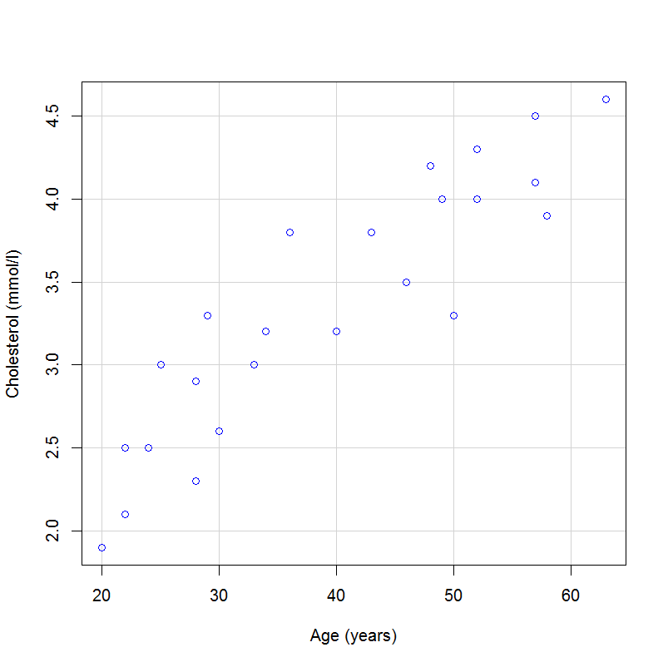
Scatter plot: Cholesterol by age
Notes:
<scatter plot>
The appropriate graphical presentation for these type of data is a scatter diagram. There appears to be some association between the values of the two variables; we can see that there is a tendency for the older people to have a higher cholesterol level.

Slide 5
What we don’t know yet…
What will be the cholesterol level of a person of 42 years old?…….

Slide 6
Regression
To describe the relation between variables
x → statistical relation → y
x = predictor / explanatory / independent variable
y = response / outcome / dependent variable
Different types of regression, depending on y and nr. of variables x
Notes:
We want to be able to predict the value of one variable for an individual when we only know the other variable. Clearly the correlation coefficient does not perform these functions; it just indicates the strength of the association as a single number.
We want a way of describing the relation between the values of the two variables, and for this general problem we need the technique called regression. Thus, the statistical relationship between a dependent variable y and explanatory variable(s) x₁, …. x_{n} can be studied by means of a regression model. There are different types of regression models. In this module we will consider the linear regression model, i.e. simple linear regression and multiple regression.

Slide 7
Simple linear regression
Only one independent variable x and one dependent y
Describe the relation between the two variables by fitting a straight line to the data that gives the ‘best’ prediction of y for any value of x
The equation of this regression line is:
y = a + bx, whereby a = intercept, b = slope
Notes:
The most simple case is where we have two variables, one independent x and one dependent y, which are both continuous, and where we are interested in a linear (straight-line) relationship.
The problem is to fit a straight line to the data that in some sense gives the ‘best’ prediction of y for any value of x.
A linear (straight-line) relation is the most simple relation between two variables. It is expressed by the equation y = a + bx, whereby b is the slope of the line and a is called intercept.

Slide 8
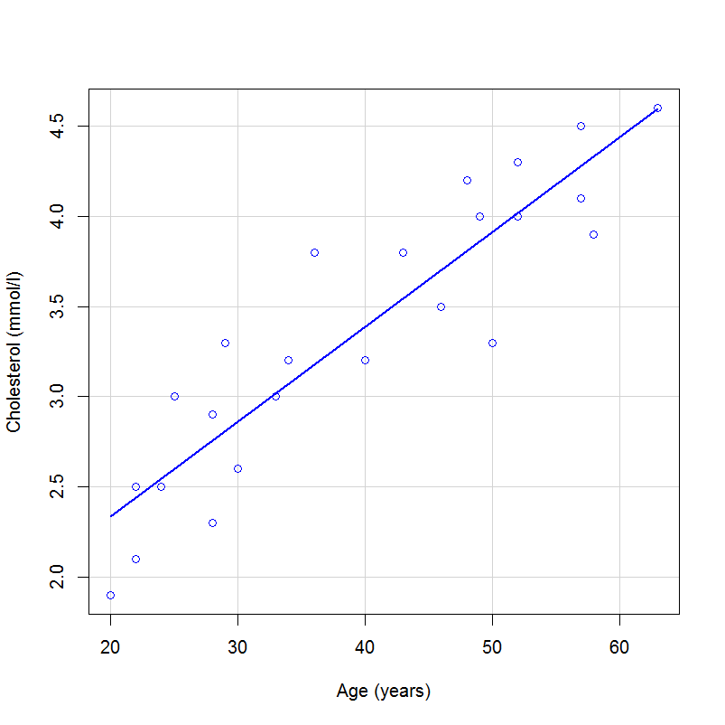
Scatter plot: Cholesterol by age with trend line
Notes:
<scatter plot with regression line>
These are the same data with a fitted regression line.

Slide 9
Intercept a: fitted value of y where the line crosses the y axis
Slope b: slope of the regression line
Notes:
<transparency with a et b>
Here you see a graphical representation of the parameters a and b.
Intercept a is the fitted value of y where the line crosses the y axis, for which x=0. In most medical applications the value of a will have no practical meaning, as the x variable cannot be anywhere near zero, e.g. blood pressure or body size. The slope b is usually the aspect of most interest.

Slide 10
Simple linear regression (ctnd)
How to fit this regression line?
-> minimize the distance between the data and the fitted line
Least squares method: minimize the sum of the squares of the vertical distances from the line (i.e. residuals)
Notes:
How to fit a straight line to the data that describes the relation between y and x in the ‘best’ way? Intuitively this will be the line that minimizes the distance between the data and the fitted regression line.
There are several possible approaches to this problem. The standard one is called least squares regression. When we use this method to fit a regression line we minimise the sum of squares of the vertical distances of the observations from the line.

Slide 11
Residual: vertical distance from the line/difference for an individual between the observed value and the fitted value
→ Minimize sum of squares of the residuals
Notes:
This graph shows the same data with the regression line, together with the vertical distances from the line. Each distance is the difference for an individual between the observed value and the value given by the line, known as the fitted value. The technical term for this distance is a residual.
We thus want to minimize the sum of squares of the residuals.

Slide 12
Mathematical symbols
sum of all x_{i}, with i from 1 to n
difference
observed value
estimated value
arithmetric mean of observed values
predicted value
real parameter in the population
b : parameter estimated by regression, based on sample

Slide 13
Calculation of the slope and intercept of the least squares regression line
S= Sums of squares
Notes:
The intercept and slope of the least squares regression line can be calculated with the help of the sums of squares S_{xx}, S_{xy} and S_{yy}. The estimated slope is given by b = Sxy/Sxx. It can be shown that the regression line always passes through the mean of the data. We can therefore estimate a simply as a = (mean y) – b * (mean x).
In our example, we calculate:
Sxx = 4139.833
Sxy = 217.858
b = 0.053
mean y = 3.354
mean x = 39.417
a = 1.280
These calculations can be done by hand or with a calculator, although it is definitely preferable to use a computer to do the calculations.

Slide 14
How does this work?
age | cholesterol | sex | occupation | bmi | activity
20 | 1.9 | M | 4 | 16.7 | 24
22 | 2.1 | F | 4 | 19.2 | 22
28 | 2.3 | M | 2 | 22.1 | 24
22 | 2.5 | M | 1 | 20.8 | 26
24 | 2.5 | F | 4 | 20.9 | 18
30 | 2.6 | M | 2 | 18.7 | 13
28 | 2.9 | F | 3 | 22.9 | 6
25 | 3.0 | M | 2 | 22.3 | 8
33 | 3.0 | F | 4 | 24.8 | 9
34 | 3.2 | M | 2 | 22.9 | 0
40 | 3.2 | M | 3 | 21.4 | 8
29 | 3.3 | F | 4 | 23.8 | 17
50 | 3.3 | F | 1 | 23.0 | 5
46 | 3.5 | M | 3 | 22.7 | 12
36 | 3.8 | F | 4 | 24.8 | 3
43 | 3.8 | F | 4 | 25.7 | 3
58 | 3.9 | M | 3 | 25.7 | 6
49 | 4.0 | M | 2 | 28 | 8
52 | 4.0 | M | 2 | 25.3 | 2
57 | 4.1 | F | 3 | 30.3 | 5
48 | 4.2 | F | 3 | 27.1 | 13
52 | 4.3 | F | 1 | 30.1 | 15
57 | 4.5 | M | 1 | 27.9 | 4
63 | 4.6 | F | 2 | 31.7 | 11

Slide 15
Your turn….
Age (years)
Price (Euro)
2
4000
How much will a car of 3.5 years cost?
3
2500
4
3000
5
1500
6
1000

Slide 16
Looking for a and b

Slide 17
Looking for a and b

Slide 18
y = 5200 – 700 x
Predicted price for a 3,5 years old car: 2750 euros

Slide 19
Can R do this?
> summary(LinearModel.1)
Call:
lm(formula = Price ~ Age, data = Car)
Residuals:
1 2 3 4 5
2.000e+02 -6.000e+02 6.000e+02 -2.000e+02 9.019e-14
Coefficients:
Estimate Std. Error t value Pr(>|t|)
(Intercept) 5200.0 692.8 7.506 0.0049 **
Age -700.0 163.3 -4.287 0.0233 *
---
Signif. codes: 0 '***' 0.001 '**' 0.01 '*' 0.05 '.' 0.1 ' ' 1
Residual standard error: 516.4 on 3 degrees of freedom
Multiple R-squared: 0.8596, Adjusted R-squared: 0.8129
F-statistic: 18.38 on 1 and 3 DF, p-value: 0.02333

Slide 20
R output cholesterol & age
Call:
lm(formula = cholesterol ~ age, data = Cholesterol)
Residuals:
Min 1Q Median 3Q Max
-0.6111 -0.2151 -0.0058 0.2297 0.6256
Coefficients:
Estimate Std. Error t value Pr(>|t|)
(Intercept) 1.279868 0.215699 5.934 5.69e-06 ***
age 0.052625 0.005192 10.136 9.43e-10 ***
---
Signif. codes: 0 '***' 0.001 '**' 0.01 '*' 0.05 '.' 0.1 ' ' 1
Residual standard error: 0.334 on 22 degrees of freedom
Multiple R-squared: 0.8236, Adjusted R-squared: 0.8156
F-statistic: 102.7 on 1 and 22 DF, p-value: 9.428e-10

Slide 21
Notes:
<scatter plot with regression line>
These are the cholesterol vs age data with a fitted regression line, incl equation.

Slide 22
What we can calculate now…
What is the cholesterol level of a person of 42 years old?…….
y = a + bx
Y = 1.28 + 0.053 x

Slide 23
What we can calculate now…
y = a + bx
Y = 1.28 + 0.053 x
thus……: y = 1.28 + (0.053 * 42)
y = 1.28 + 2.2
cholesterol level = 3.49 mg/ml

Slide 24
Simple linear regression (ctnd)
How well does the line fit the data?
Total variation (of the dependent variable) =
Variation explained by the linear regression +
residual variation
The smaller the residual variation,
the better the regression line fits the data (‘goodness-of-fit’)
Notes:
The residual variation indicates the variation NOT explained by the regression line, in other words the total variation of the dependent variable minus the variation explained by the regression line.
The residual variation is thus a measure of the ‘goodness-of-fit’ of the line. The smaller the residual variation, the better the regression line fits the data.

Slide 25
Notes:
<scatter diagram with regression line y= mean y>
Here you see the graphical representation. The total variation can thus be partitioned into a component explained by the regression line and unexplained or residual variation.

Slide 26
Calculation of residual variation
Total variation:
Variation explained by regression:
Residual variation:
Notes:
Like for the slope and intercept, the residual variation can be calculated with the help of the sums of squares S_{xx}, S_{xy} and S_{yy}.

Slide 27
Table of analysis of variance
Estimated variance
Residual variance
Notes:
This partitioning of the total variation of the dependent variable into a component explained by the regression line and unexplained / residual variation is often displayed in an analysis of variance table.
The sums of squares have been explained in the previous slide. Each sum of squares is converted into an estimated variance (known as mean square) by dividing by its degrees of freedom. Following the usual principle that the degrees of freedom for a variance are one less than the number of observations, there are n-1 degrees of freedom. The degrees of freedom for the linear regression equals the number of independent variables; thus, for a simple linear regression d.f. = 1. The degrees of freedom for the residual variation can be obtained by subtraction, so for a simple linear regression d.f. = n-2. The variance of the residual variation is also called ‘residual variance’.
The table of analysis of variance is a convenient way to have an overview on all values relevant for the linear regression. From this table one can proceed to...:
the calculation of the determination and correlation coefficients
the appropriate statistical test
the calculation of the confidence interval for the regression line
the calculation of the confidence interval for a predicted value

Slide 28
ANOVA table cholesterol vs age
> anova(LinearModel.2)
Analysis of Variance Table
Response: cholesterol
Df Sum Sq Mean Sq F value Pr(>F)
age 1 11.4648 11.4648 102.75 9.428e-10 ***
Residuals 22 2.4548 0.1116
---
Signif. codes:
0 ‘***’ 0.001 ‘**’ 0.01 ‘*’ 0.05 ‘.’ 0.1 ‘ ’ 1
Source | SS | df | MS
Regression | 11.47 | 1 | 11.47
Residual | 2.45 | 22 | 0.11
Total
Notes:
ANOVA table for our example on cholesterol vs age

Slide 29
ANOVA table cholesterol vs age
> anova(LinearModel.2)
Analysis of Variance Table
Response: cholesterol
Df Sum Sq Mean Sq F value Pr(>F)
age 1 11.4648 11.4648 102.75 9.428e-10 ***
Residuals 22 2.4548 0.1116
---
Signif. codes:
0 ‘***’ 0.001 ‘**’ 0.01 ‘*’ 0.05 ‘.’ 0.1 ‘ ’ 1
Source | SS | df | MS
Regression | 11.47 | 1 | 11.47
Residual | 2.45 | 22 | 0.11
Total | 13.93 | 23 | -
Notes:
ANOVA table for our example on cholesterol vs age

Slide 30
Determination coefficient
Determination coefficient: proportion of total variation of y attributable to the linear regression:
SS regression r² = –––––––––––– SS total
0 ≤ r² ≤ 1; if close to 1-> model explains a high proportion of the variation
Link between coefficient of determination and correlation coefficient:
r = ± √ r²
Notes:
The determination coefficient r² is the proportion of the total variation of y attributable to the linear regression. The closer it gets to 1, the better the regression line fits to the data (i.e the smaller the residual or unexplained variation). r² is often expressed as a percentage.
The correlation coefficient r is a measure for the force of the linear relation between the independent and the dependent variable. The nearer to 1 or -1 r is, the stronger is the linear relationship between x and y. In the context of the simple linear regression, the correlation coefficient furthermore informs us whether the slope is positive or negative:
0 < r ≤ 1 ⇒ b > 0
-1 ≤ r < 0 ⇒ b < 0
It is important to insist on the fact that r is a measure for the force of a linear relationship. If the relationship is non-linear, for example parabolic, the relationship may be perfect, but r = 0 nevertheless.

Slide 31
ANOVA table cholesterol/age
Source | SS | df | MS
Regression | 11.47 | 1 | 11.47
Residual | 2.45 | 22 | 0.11
Total | 13.93 | 23 | -
R²= 11.47/13.93 = 82.3%
Notes:
ANOVA table for our example on cholesterol/age
r² = 11.47/13.93 = 0.823
r = √ 0.823 = 0.9074

Slide 32
82.3% of the variation is explained by the regression line, so it is a good model
Notes:
<scatter plot age/cholesterol with r² and r>
Here you see the scatter plot of the age/cholesterol data with the fitted linear regression line and the accompanying determination and correlation coefficient.

Slide 33
R² - “Goodness of fit”
Good fit ⇒ R² high
High variance explained
Moderate fit ⇒ R² lower
Less variance explained

Slide 34
Statistical test
Y = α + β X + ε: regression model for the population
H₀: β = 0 H₁: β ≠ 0
MS regression
F = ––––––––––––
MS residual
df = (df regression; df residual)
Notes:
There are several possibilities to perform a statistical test on a simple linear regression:
t-test for H₀: r = 0
t-test for H₀: a = arithmetic mean of y
t-test for H₀: b = 0
F-test for H₀: b = 0
We shall concentrate on the F-test on the slope b because it is also applicable for multiple regression.
We test H₀: β=0 vs H_{1 :} β#0, test statistic F = MS regression/MS residual with df given by (regression df, residual df).

Slide 35
ANOVA table cholesterol/age
Source | SS | df | MS
Regression | 11.47 | 1 | 11.47
Residual | 2.45 | 22 | 0.11
Total | 13.93 | 23 | -
F = 11.47/0.11 = 104.3 (or without rounding (11.4648/1) / (2.4548/22) = 102.75)
Notes:
ANOVA table for our example on cholesterol/age
In our example about the relationship between age and cholesterol in plasma, the F-value is: F = 11.47/0.11 = 104,2 with df (1;22)

Slide 36
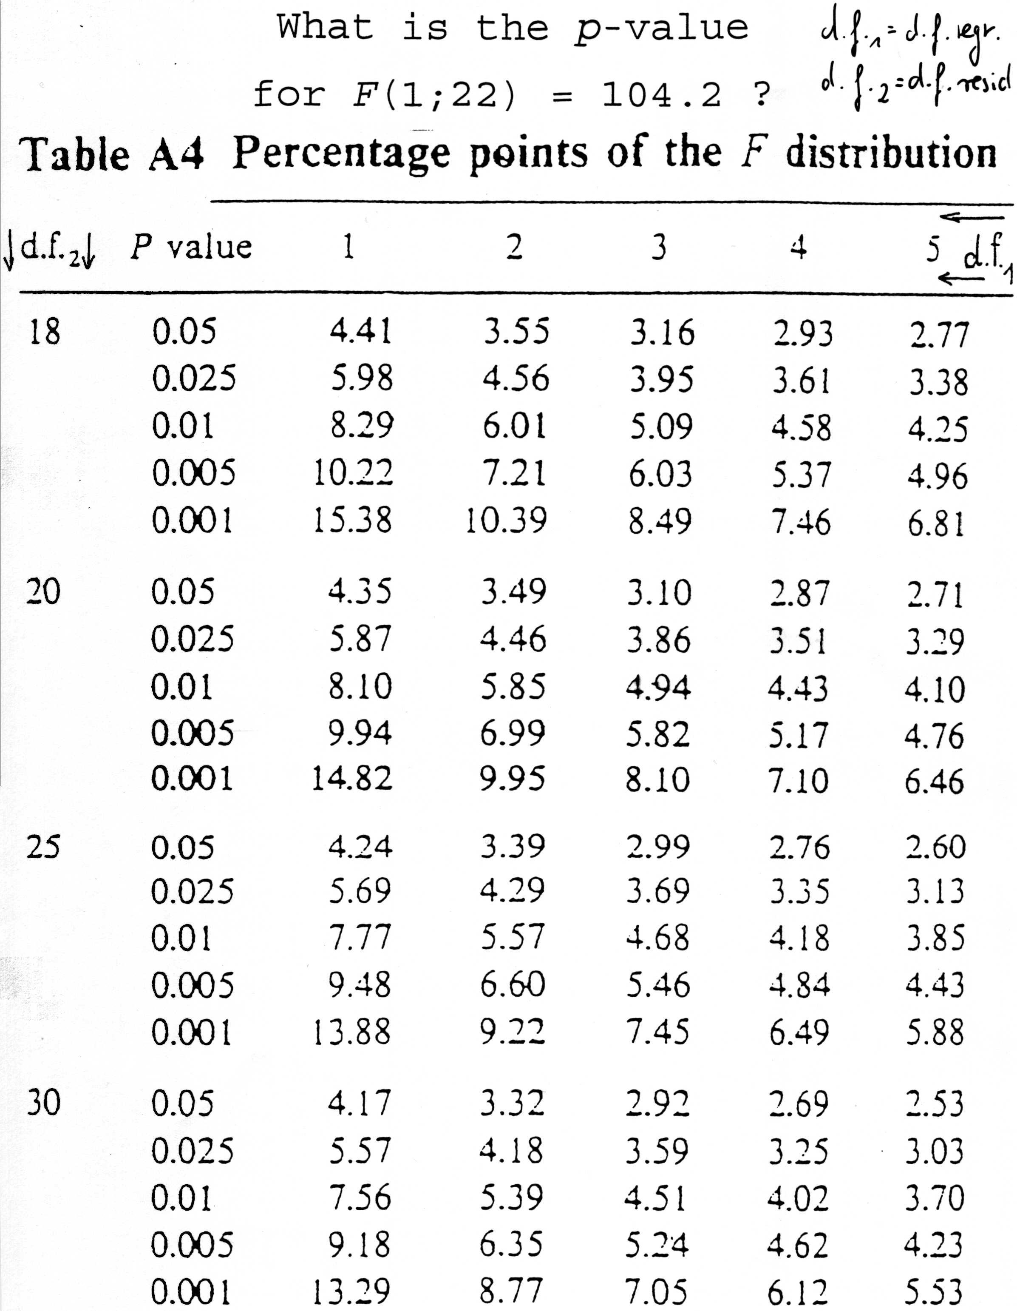
p<<<0.001 -> reject H₀, i.e. the slope of the regression line is significantly different from zero
Notes:
<table with p-values p for an F-distribution>
⇒ p << 0,001
We reject H₀, i.e. the slope of the regression line is significantly different from zero.

Slide 37
F-test and T-test
T statistic = √F-statistic
Only valid for independent variable with 2 levels
DF numerator = 1
DF denominator = n-2

Slide 38
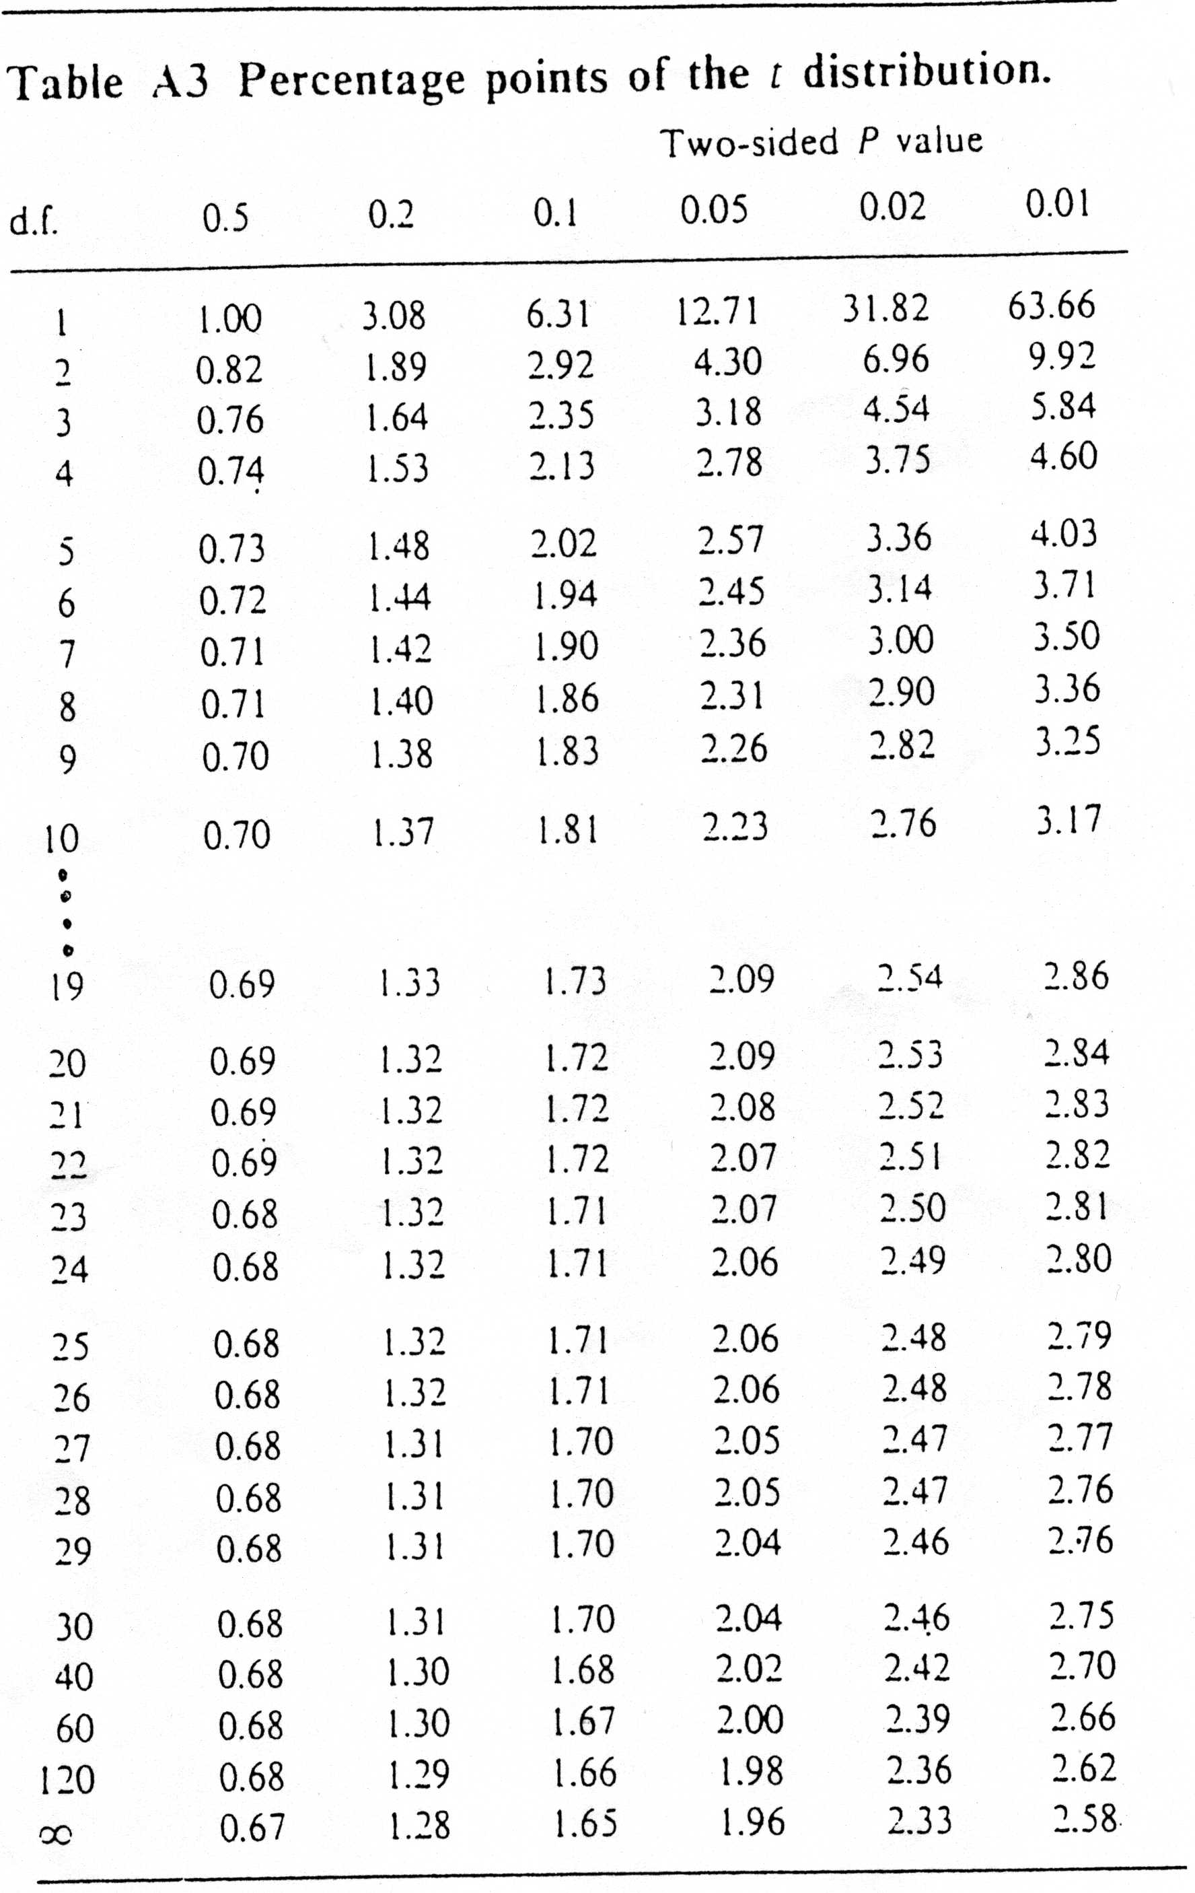
Notes:
<p-values of t distribution>
The t-value can be found in tables with the t distribution.
In our example, n = 24. The corresponding t_{n-2} value for the conventional p = 0.05 is t_{n-2}=2.07.

Slide 39
Confidence interval for the regression line
95% CI = y’ ± t_{n-2} * s.e.(y’) with:
Notes:
For the regression line, a confidence interval can be calculated that expresses the uncertainty around the line.
This interval is large if: (see formula)
n is small,
the residual variance = the residual mean square is large,
if x’ is far from the mean of x.

Slide 40
Notes:
<CI and CI-y^ of regression line>
Here you see a graphical representation of the confidence interval of the regression line in our example on cholesterol vs age.

Slide 41
Prediction interval: CI for predicted value
95% CI = y’ ± t_{n-2} * s.e.(y’), with:
avoid extrapolation!
Notes:
One common use of the regression line is to predict y at a given value of x. This is achieved merely by substitution of the particular x-value into the equation of the regression line y = a + bx.
It should be remembered that the regression line should not be used to make predictions for x values outside the range of values in the observed data. Such extrapolation is unjustified as we have no evidence about the relationship beyond the observed data.
The uncertainty of the estimated y’ is expressed as usual by the confidence interval.
Exactly as before, for the CI of the whole regression line, the CI for a predicted individual value is large if: (see formula)
n is small,
the residual variance (= the residual mean square) is large,
if x’ is far from the mean of the x values.

Slide 42
ANALYSIS OF VARIANCE
RMS =S²
Source
SS
df
MS
Regression
11.47
1
11.47
Residual
2.45
22
0.11
Residual mean square = residual variance
Total
13.92
23
-
95 % C.I. for regression line
95 % C.I. for predicted value

Slide 43
Notes:
<CI and CI-y^ for regr. line and predicted values>
Here we see a graphical representation of the difference between the CI of the whole regression line vs. the CI for single predicted values (i.e. prediction interval).
The incertitude around a single predicted value is much larger than the incertitude around the regression line as a whole. This can be understood considering that the regression line is a summary function of many (more exactly: n) observations. A single observation can vary more freely because in principle it is not linked to other observations.

Slide 44
…what we’ve learnt so far:
Scatter plot
Linear equation
Residual variation
Table of analysis of variance
Coefficient of determination
Correlation coefficient
Statistical test: F-test
Confidence intervals

